Slide 1



Safe City Mardan User Manual

Slide 2
Table of Contents:
White
Is the color of milk and fresh snow, the color produced by the combination of all the colors of the visible spectrum.

Slide 3
System Requisites
The following components will be required to operate the System:
A computer(Any specification) with an access to the local GPU server.
A web browser (Any)

Slide 4
Precautions
The following precautions have to be taken in order :
Ensure that the GPU based server is up and running at all times.
Ensure that the GPU based server is connected to the local network.

Slide 5
Running and Operating the System:
In order to operate the system, the following steps have to be followed.
Open web browser.
Go to Url: https://192.168.10.240/proj/NCAI/SCM
Login
A user interface will be opened, allowing to use the system.
The detailed instructions of the user interface are given the below

Slide 6
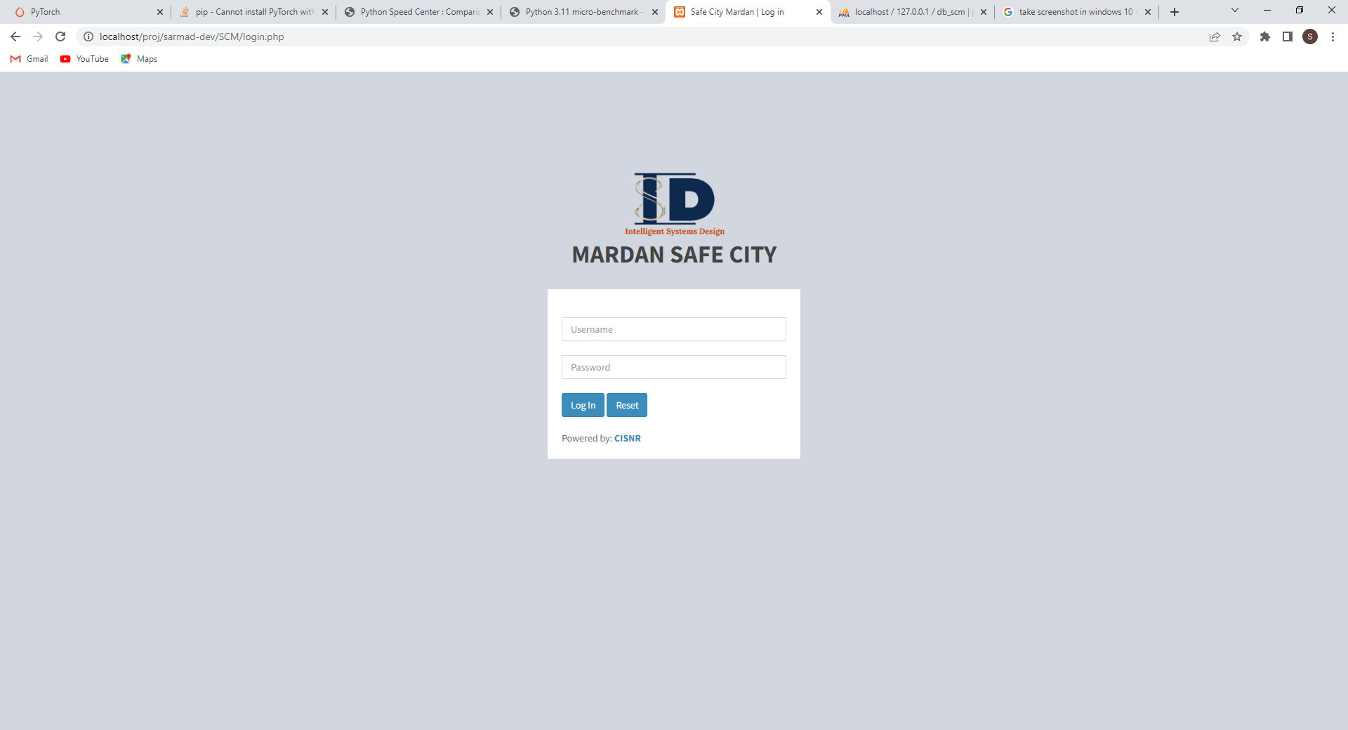
Enter Username
Enter Password
Press to Login
Reset Password

Slide 7
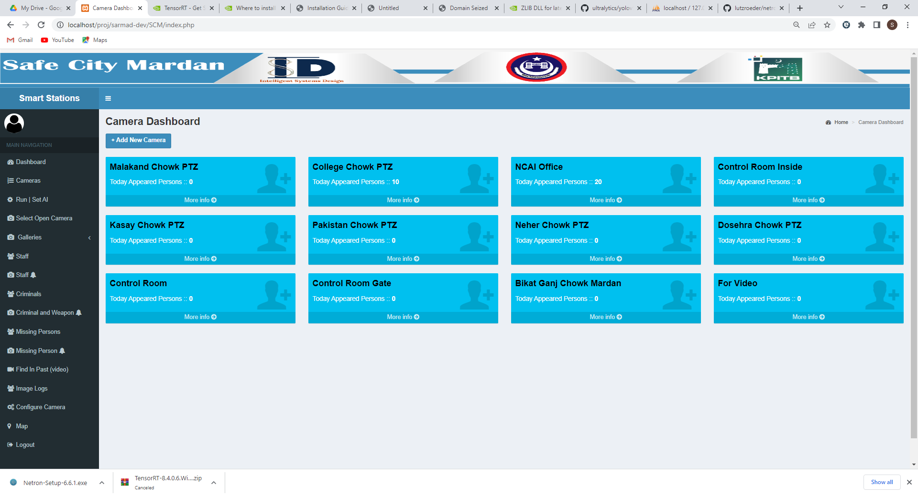
This is the camera dashboard, count of person matched with database will be shown here
Click on camera to see its logs
Click to add new camera
All the pages are accessible from sidebar

Slide 8
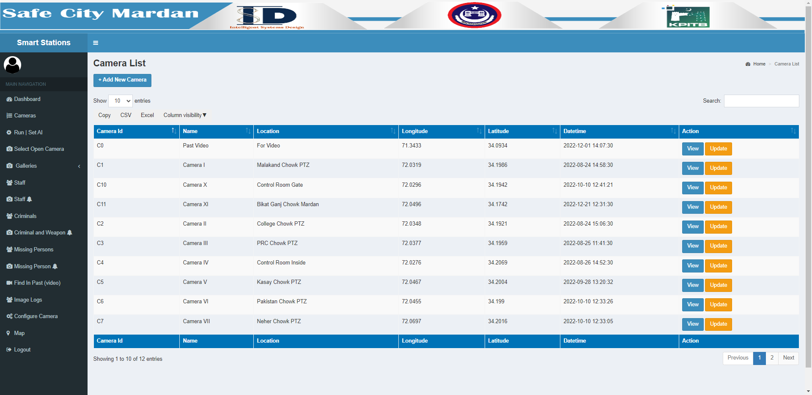
This is the Camera list interface, all the added cameras will be shown and updated here.
Furthermore, this interface is also used to add new camera.
Add new camera (Check Page-8)
Search for a camera
View logs, and update buttons
Number of entries to show
Hide Show Columns
Export Information to Excel, CSV or Copy to Clipboard
Go to next/previous page

Slide 9
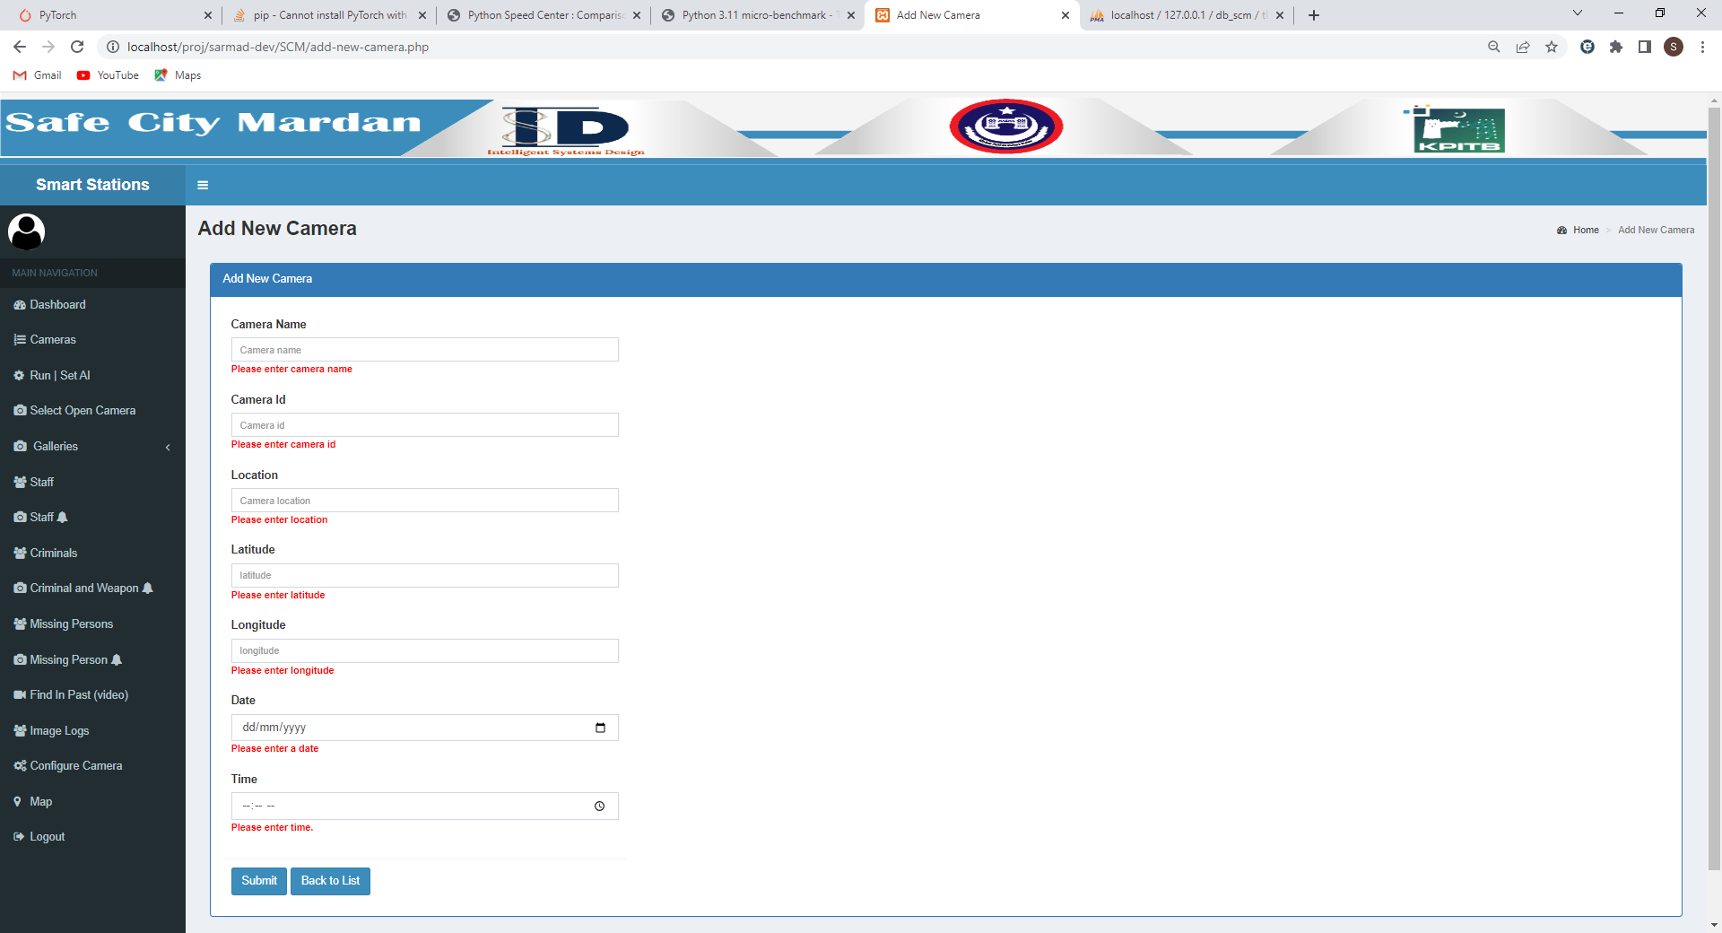
Upon Clicking on Add new camera, the user will be redirected
Enter Data as per Instructions
And Submit

Slide 10
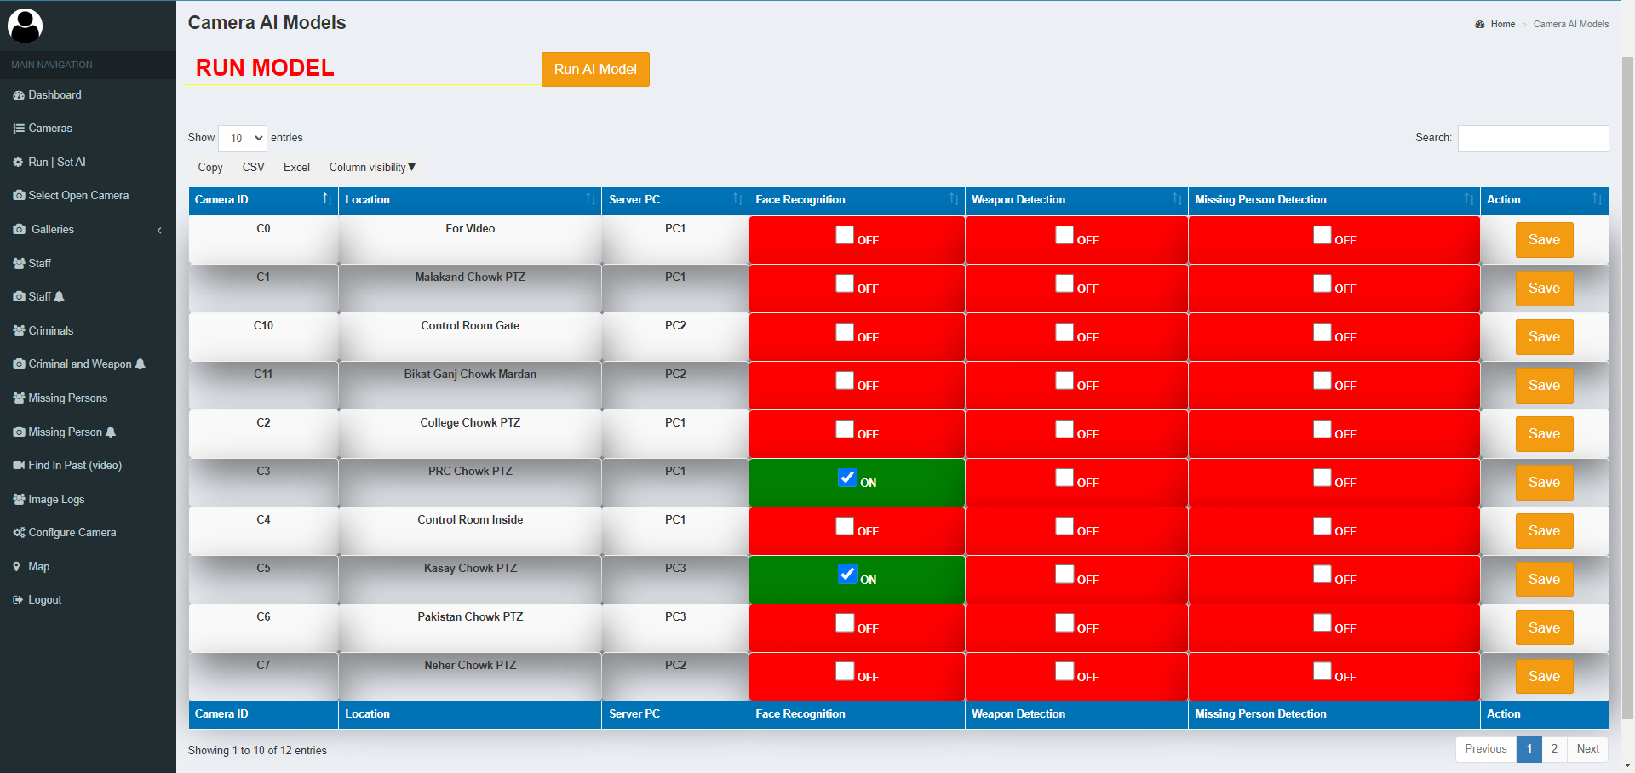
This interface allows you to Run or Stop the AI features. It also allows to turn on or off specific features for specific camera
Turn on or off Mission Person
Press to Run AI Model
Turn on or off Face Recognition
On Specific Camera
Turn on or off Weapon Detection
Click Save to save feature settings

Slide 11
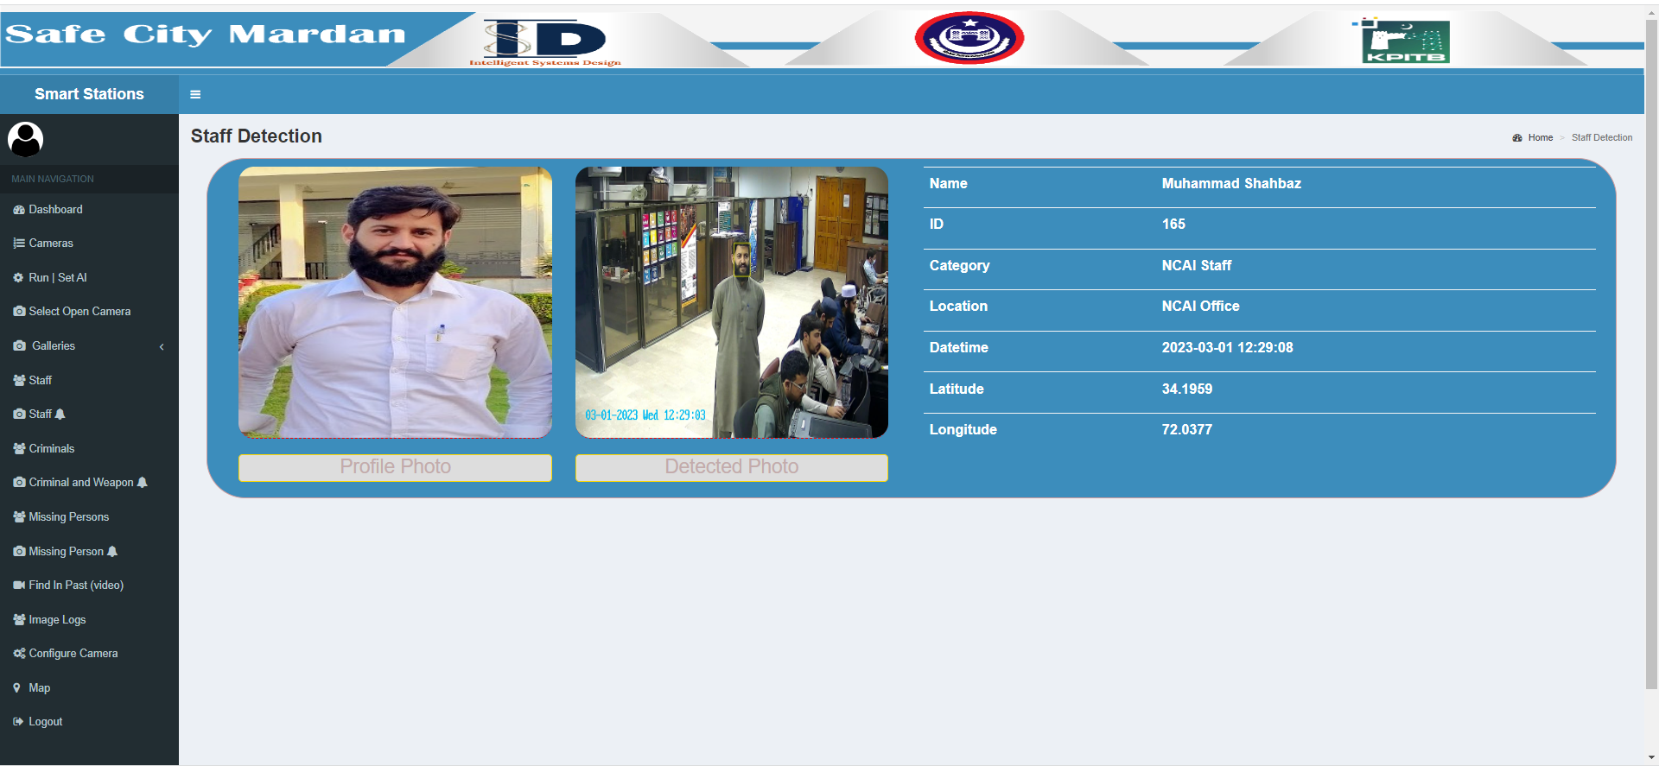
This is the detection dashboard, the latest detection along with relevant information will appear here

Slide 12
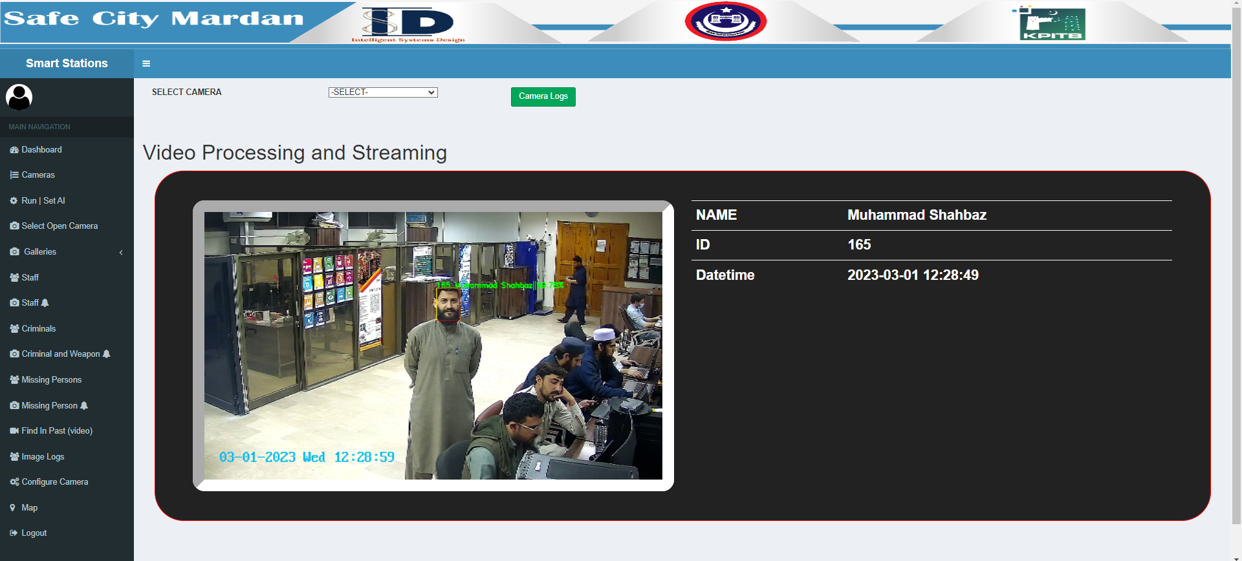
This is the livestreaming dashboard, the live stream will appear here.
Select camera to see its live streaming
Press to see feed
Detection information will appear here
Live feed will appear here

Slide 13
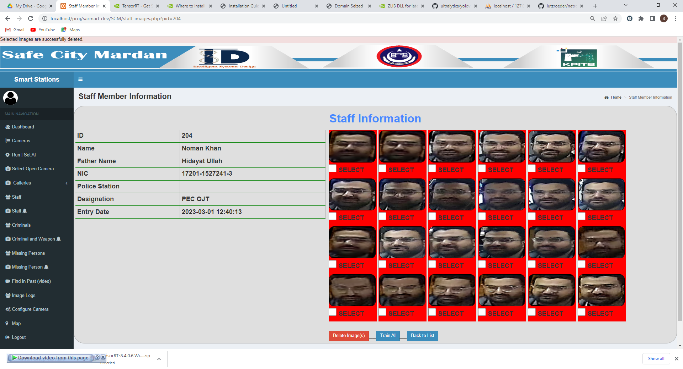
This is the Criminal Image View, Images can be deleted, training can be done from here.
These cropped images are used to train AI model to know this person.
The above images can be deleted, or model can be traine, from respective buttons.

Slide 14
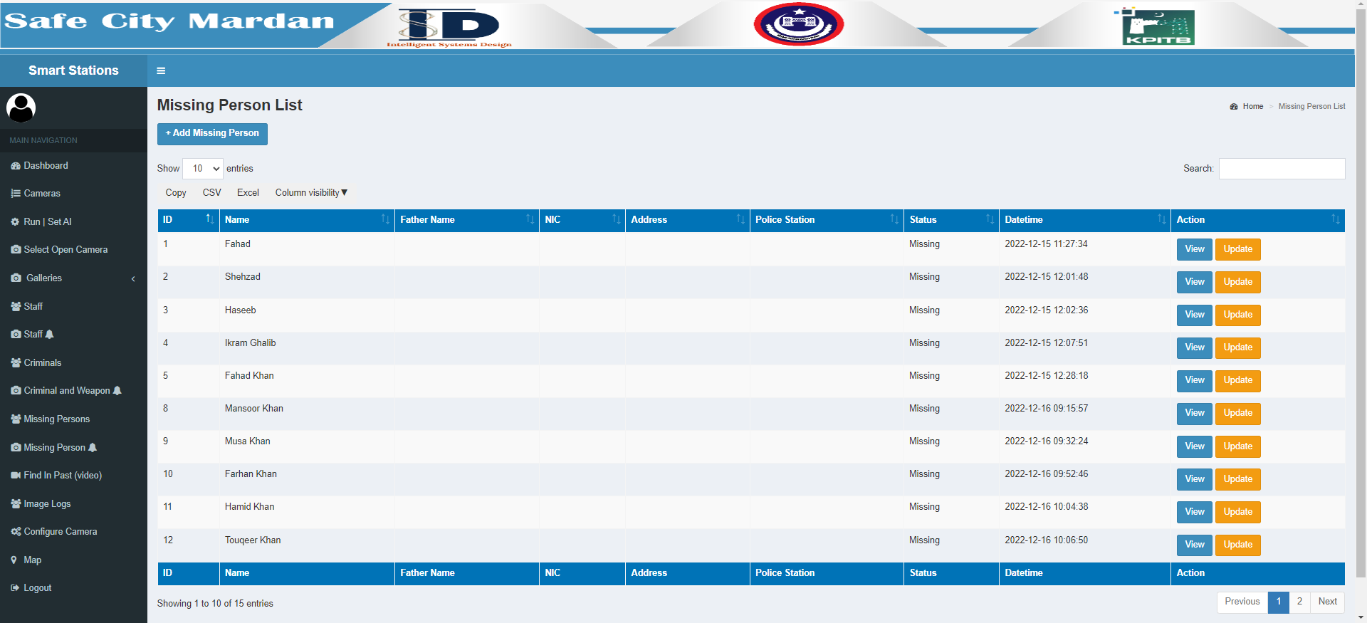
This is the Missing Persons list Dashboard, where you can add, update and view missing person logs from.
Button to add new missing person
Update Button
View Logs

Slide 15
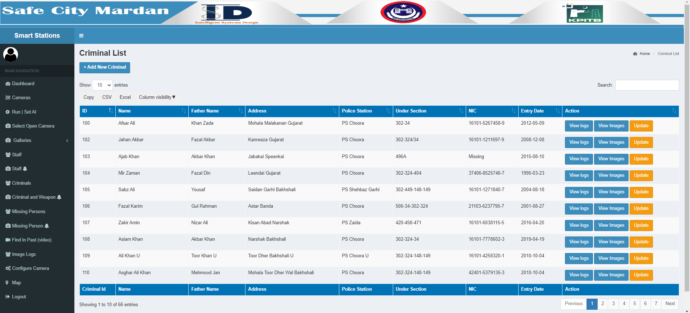
This is the Criminals list Dashboard, where you can add, update and view Criminals logs from.
Add new criminal button
View logs, images, and Update Criminal button

Slide 16
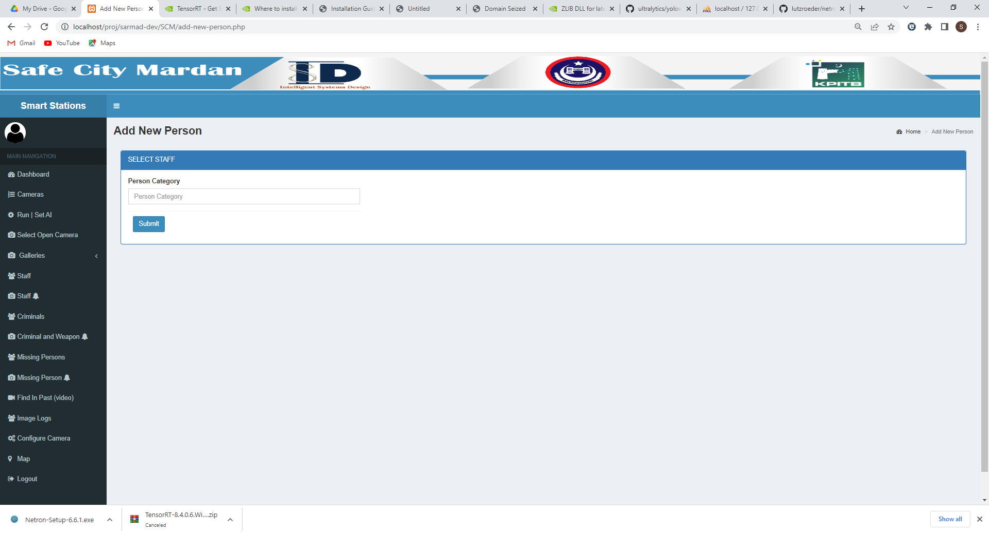
This is the Add New Criminal or Staff Dashboard based on category you select.
Select Category and Submit.

Slide 17
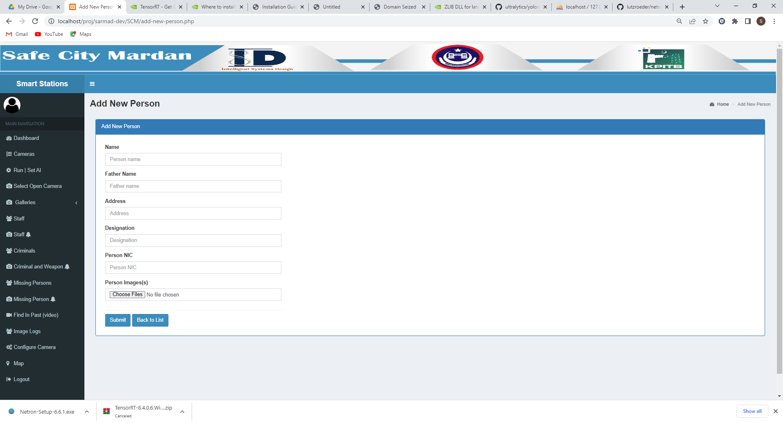
This is the Add Criminal/Staff Dashboard based on the selected category.
Enter data in corresponding field and submit form.

Slide 18
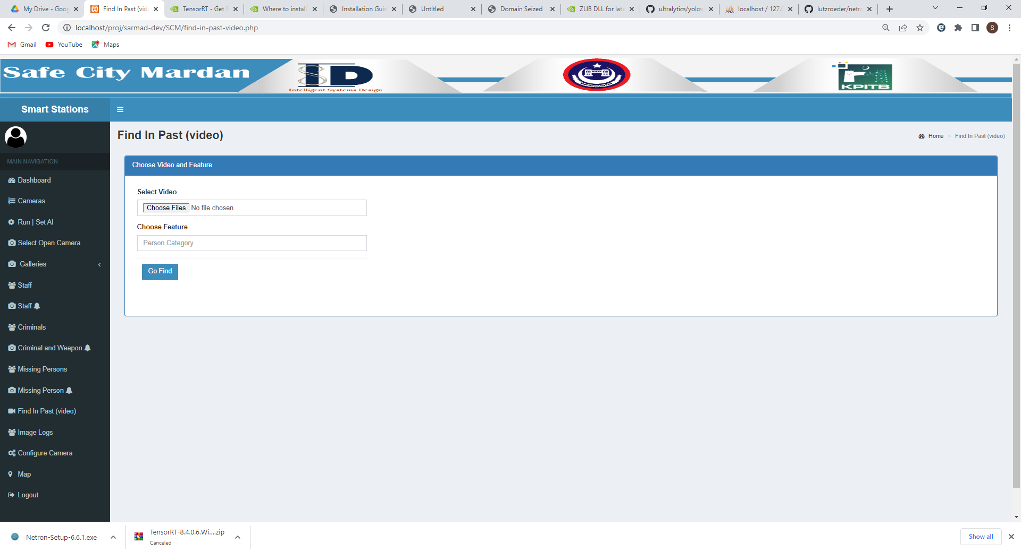
This is the Video Upload Dashboard, where you can choose video, Select Feature and run the AI.
Choose Video File.
Select Feature
Run AI.

Slide 19
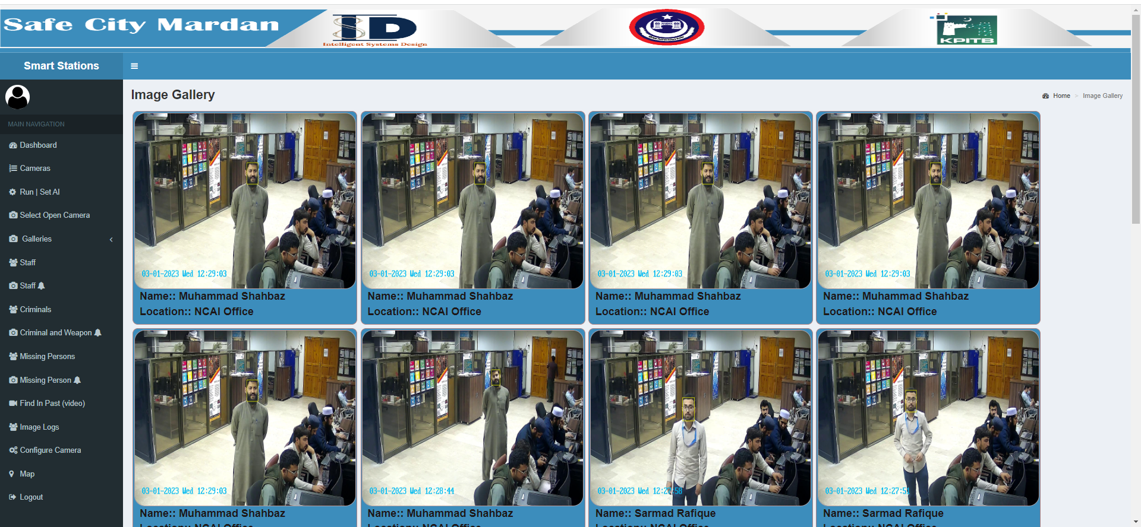
This is the Image(s) Gallery Dashboard, where you can see all the detected images of criminals, staff, and missing persons, with name and location.
Hover over image to zoom in.

Slide 20
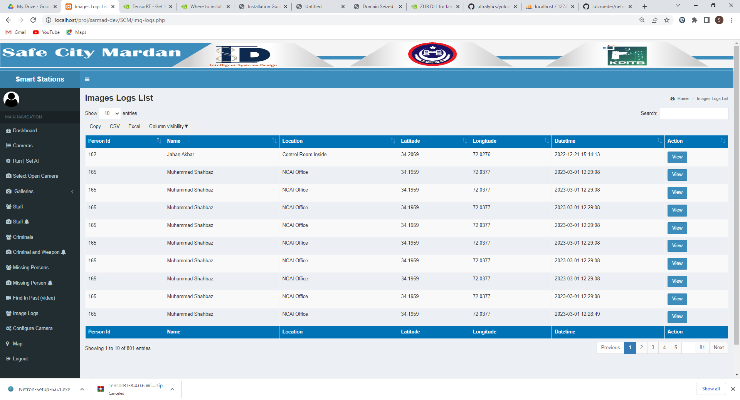
This is the commutative detection logs in list form, where you can click view to see image.
The view button.

Slide 21
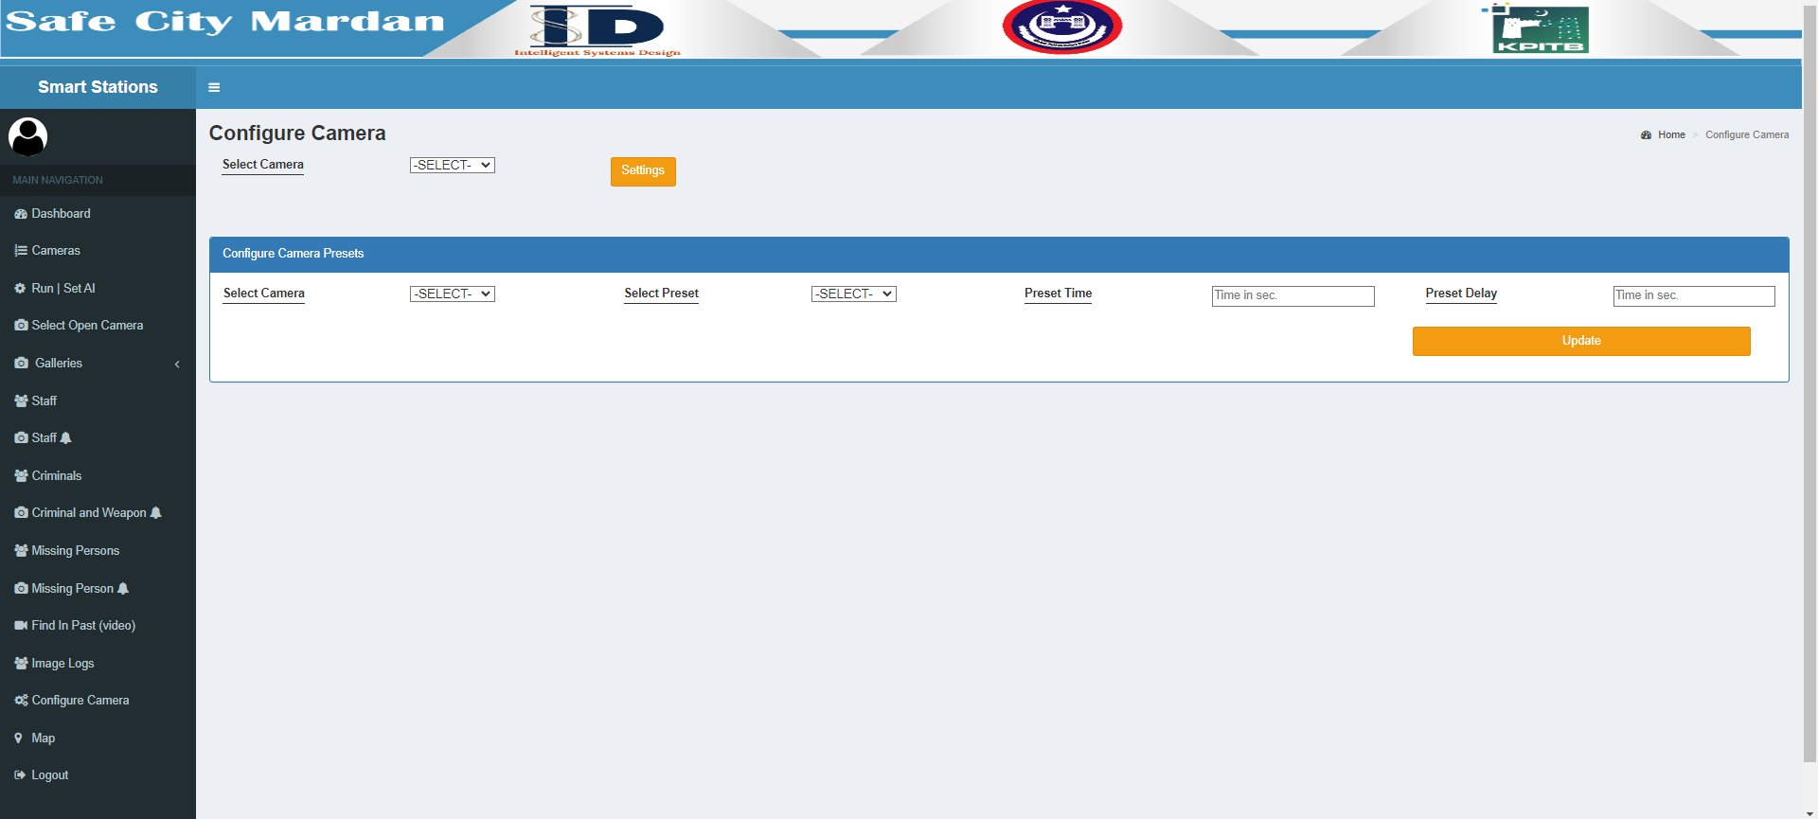
This is the Configure Camera Dashboard, where you can select and configure any camera attribute.
Select Camera and click settings.
Select and configure presets..

Slide 22
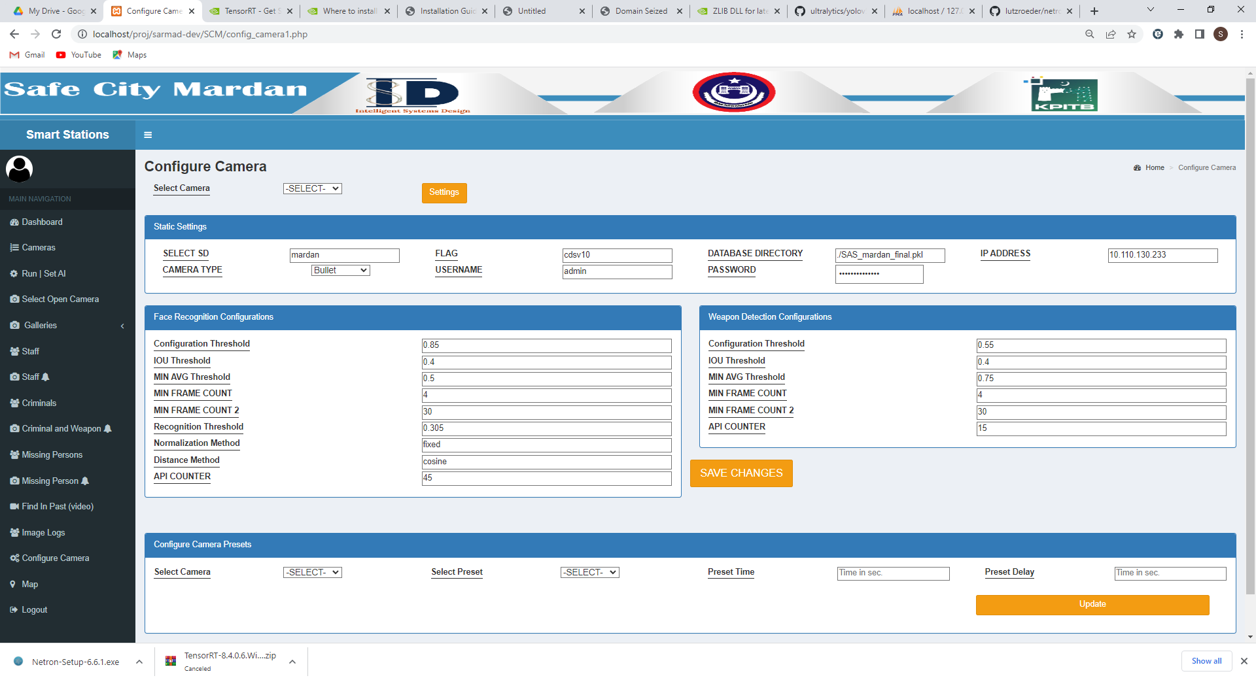
This is the Camera Configuration Dashboard that appears when you select camera and click settings, here you can enter data according to instructions given.

Slide 23
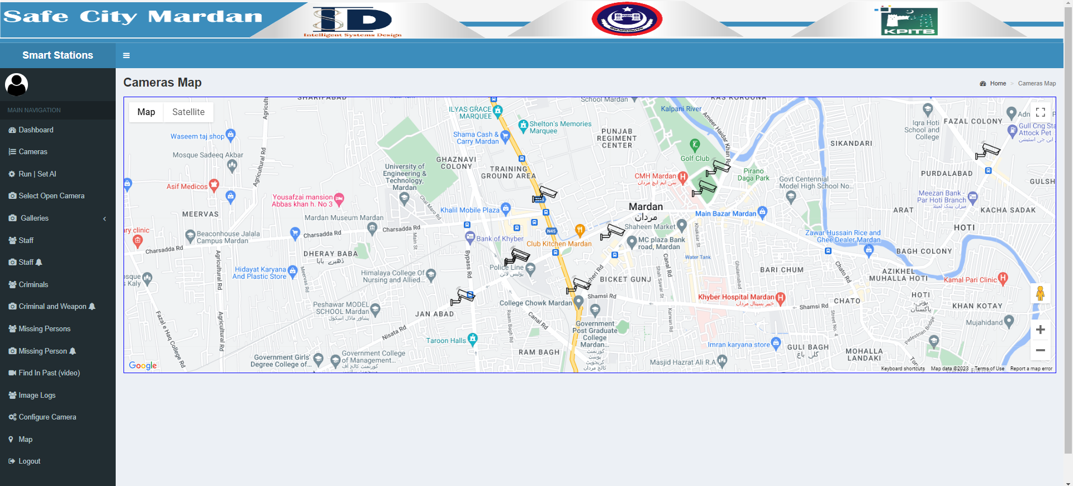
This is the Map Dashboard, where you can find location of each camera.
This sign indicates camera location point.

Slide 24
Thank You

